Slide 1
INTRODUCTION TO MICROSOFT POWER BI
Sourav Karmakar
souravkarmakar29@gmail.com

Slide 2
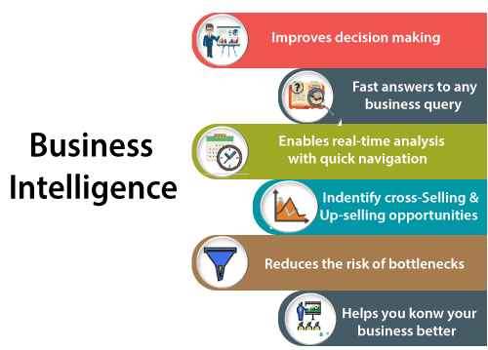
What is Business Intelligence (BI)?
The BI term refers to Business Intelligence. It is a data-driven decision support system (DSS), which helps you to analyze the data and provide actionable information. It helps the business manager, corporate executives, and other users in making their decisions easily.
Business intelligence refers to the applications, technologies, and practices for the collection, analysis, integration, and presents the business information. The purpose of business intelligence is to support better decision making.
Sometimes the business intelligence is used interchangeably with briefing books, reports, query tools, and executive information systems.
The below image shows the benefits of business intelligence, such as:

Slide 3
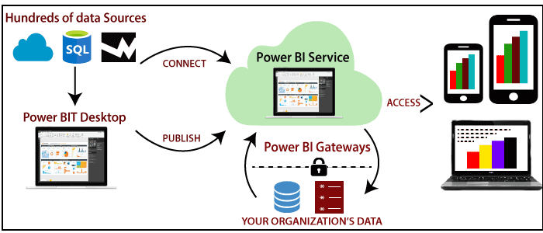
What is Power BI?
Power BI is one of the most popular Data Visualization and Business Intelligence tool developed by Microsoft. The Power BI tool is the collection of apps, data connectors, and software services which are used to get the data from different data sources, transforms data, and produces useful reports.
It provides interactive visualizations with self-service business intelligence capabilities where end users can create reports and dashboards by themselves, without having to depend on information technology staff or database administrators.

Slide 4
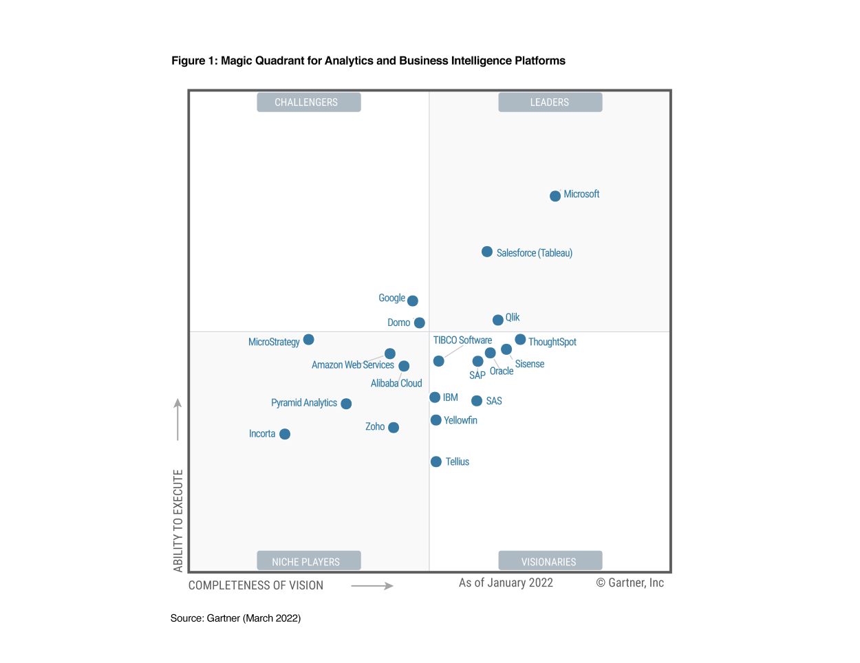
Advantages of Power BI
As per Gartner, Microsoft Power BI is the leader in terms of available Business Intelligence tools (as you can see in the above picture)

Slide 5
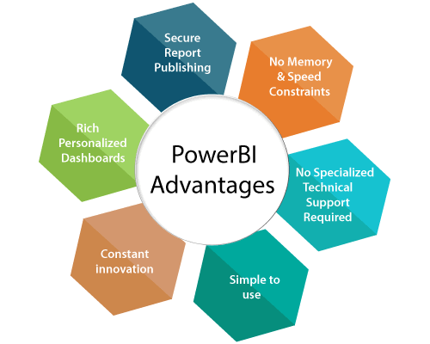
Advantages of Power BI
Moreover, most of the functionalities of Power BI are free to use (i.e. you don’t need license for it).

Slide 6
Advantages of Power BI
Secure Report Publishing: You can automate setup data refresh and publish reports that allowing all the users to avail the latest information.
No Memory and Speed Constraints: To Shift an existing BI system into a powerful cloud environment with Power BI embedded eliminates memory. Speed constraints ensure that data is quickly retrievable and analyzed.
No Specialized Technical Support required: The Power BI provides quick inquiry and analysis without the need for specialized technical support. It also supports a powerful natural language interface and the use of intuitive graphical designer tools.
Simple to Use: Power BI is simple to use. Users can easily find it only on behalf of a short learning curve.
Constant innovation: The Power BI product is updated in every month with new functions and features.
Rich, personalized dashboard: The crowning feature of Power BI is the information dashboards that can be customized to meet the exact need of any enterprise. You can easily embed the dashboards, and BI reports in the applications to provide a unified user experience.

Slide 7


Download Power BI
Step-1: Search in google for Microsoft Power BI download
Step-2: Go to the link: https://powerbi.microsoft.com/en-us/downloads/

Slide 8
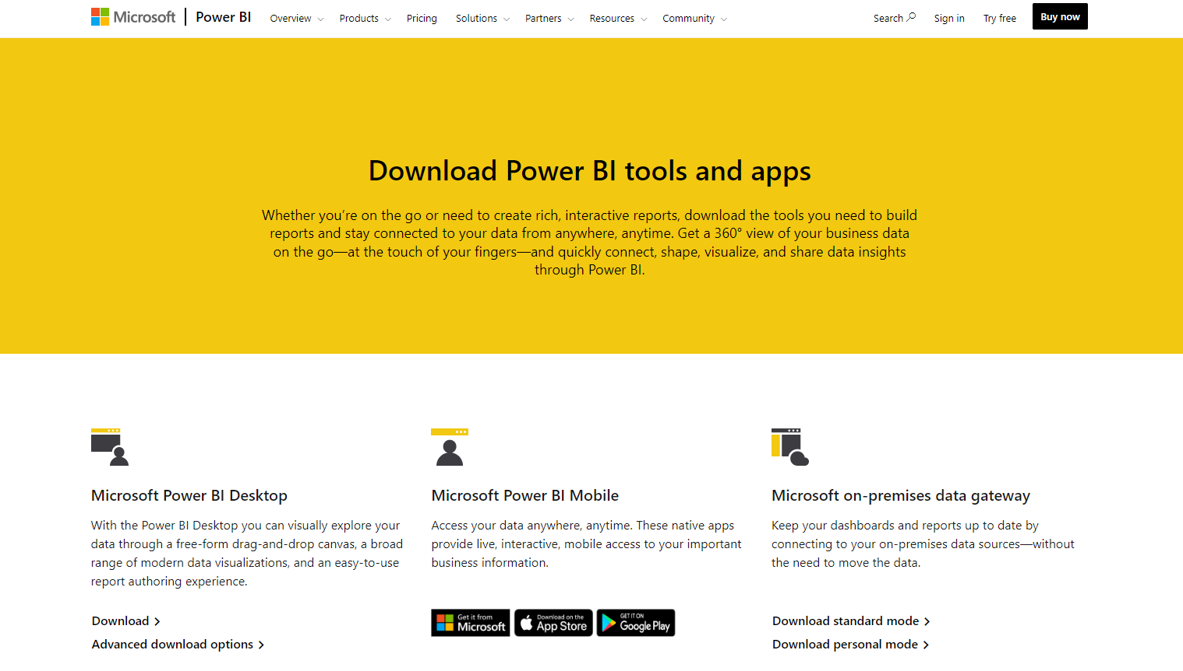
Download Power BI
Step-3: Click on the Advanced download options under Microsoft Power BI Desktop

Slide 9
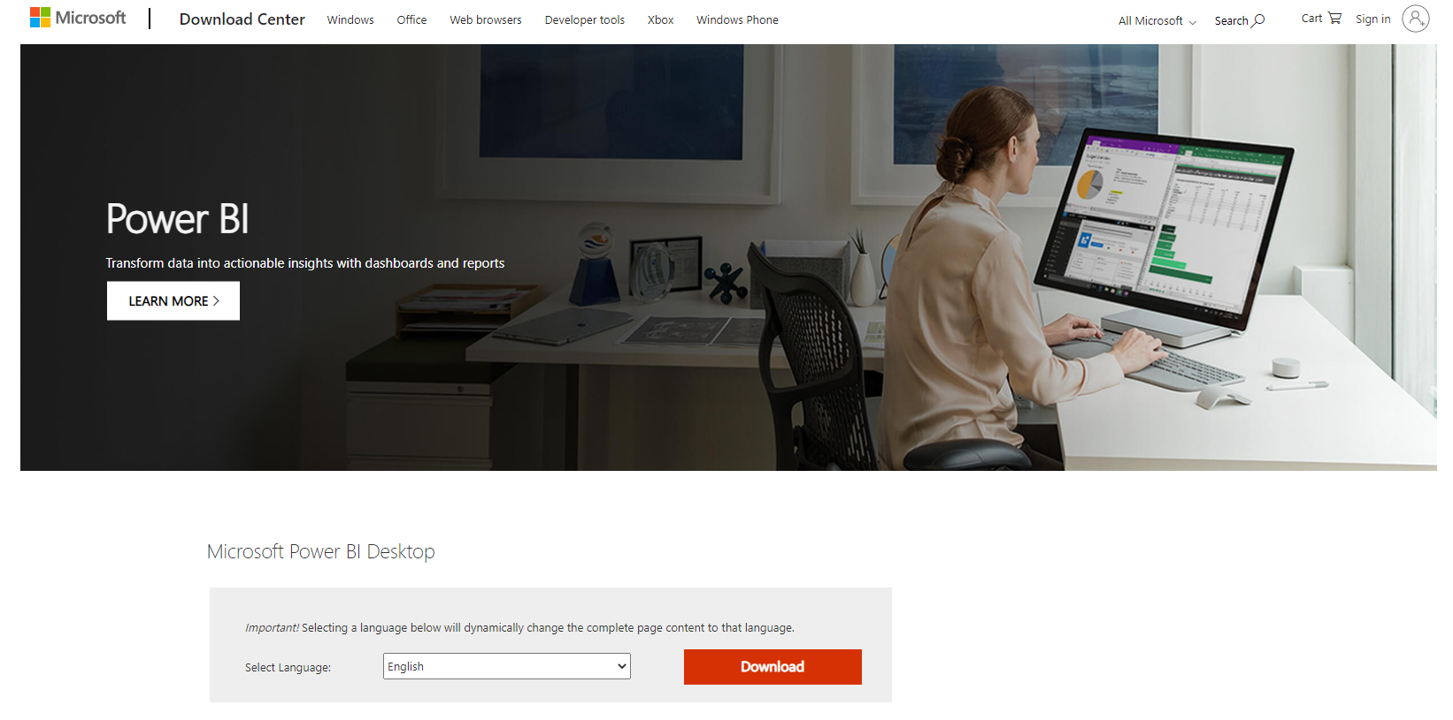
Download Power BI
Step-4: Click on the Download button

Slide 10
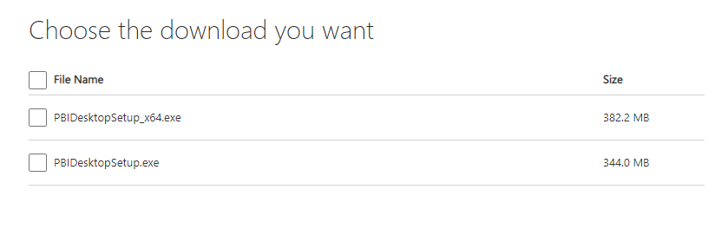
Download and Install Power BI
Step-5: Choose the .exe file to your local machine.
Step-6: Once the installer (.exe file) is downloaded click on it to install Power BI to your local machine.
Now you are ready to use Power BI in your local machine.
You may choose or not to choose sign in. If you don’t have Power BI license just ignore the sign in step and use it as it is.
Power BI is not available for Mac or Linux machines.

